Slide 1
MUSIC RECOMMENDED SYSTEM USING PYTHON
Students Number: 20020071, 20005553
Name: Bodapati Abhiteja, Nikant Sharma
Course Title: M.Sc. Cyber Security
Lecturer Name: Swati Dongre
Module/Subject Title: Advanced Programming Techniques
Assignment Title: CA_TWO_(70%)

Slide 2
Introduction:
We have created a music recommendation website primarily using python and have trained an NLP model usings pandas dataframe, Jupyter notebook for IDE.
For music Dataset, We downloaded a dataset in .csv file from Kaggle which accounted for a spotify based dataset.
The objective is to create a trained model using machine learning algorithms with utility of Python as the primary language.
The model absorbs an input from the user with respect to a song selection from the list of songs with a given dataset.
The model then recommends not 1 or 2 but 5 similar songs to the user as a response.

Slide 3
Steps involved in building the Music recommended system:
Data collection: The model uses a dataset of 45 million songs with lyrics from Kaggle.
Data preprocessing: This involves cleaning the data by removing extra spaces, backslashes, and other special characters.
Feature engineering: The lyrics are converted into numerical vectors using TF-IDF technique used to train an NLP Model.
Model building: The cosine similarity is calculated between the vectors of the different songs. We could have implemented the same outcome using the Euclidean distance however, the cosine similarity gave a more refined output.
Recommendation: The top 5 songs with the closest cosine similarity to the selected song are recommended to the user.
Web application deployment: The recommender system is deployed as a web application using Streamlit.

Slide 4
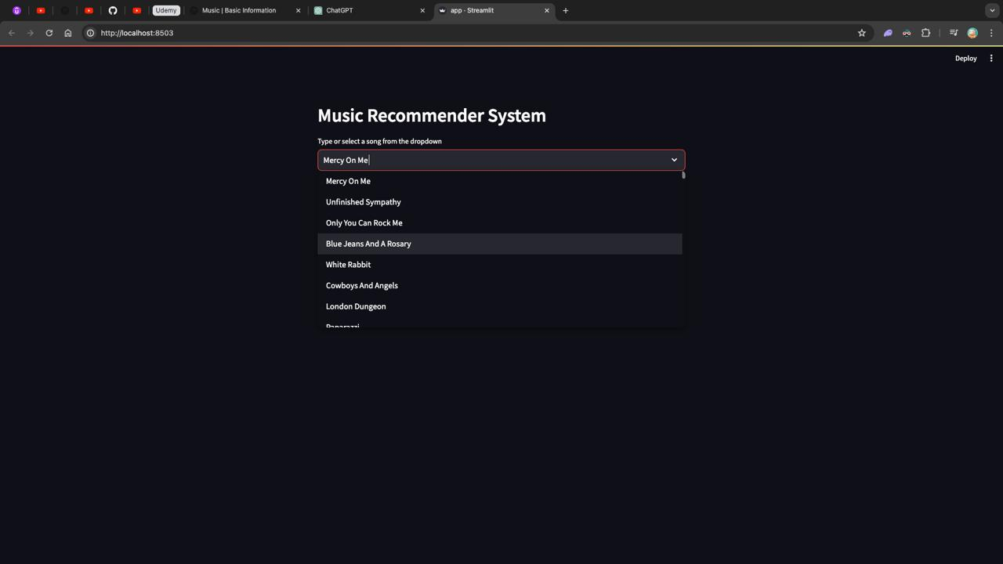
Website output:
The user inputs a particular song from the list of songs -

Slide 5
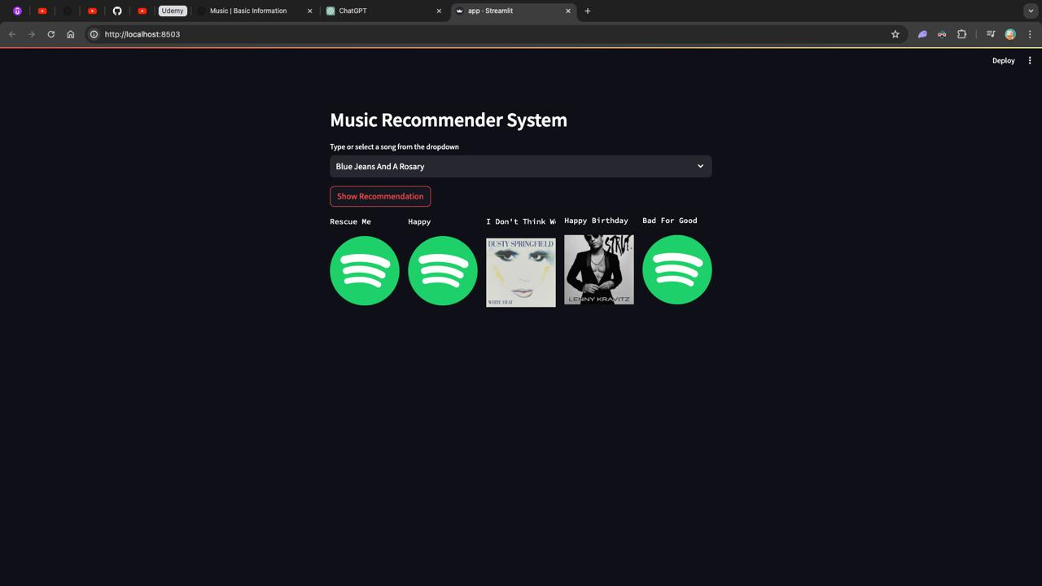
The NLP based model responded with 5 song recommendations with the closest cosine similarity value.

Slide 6
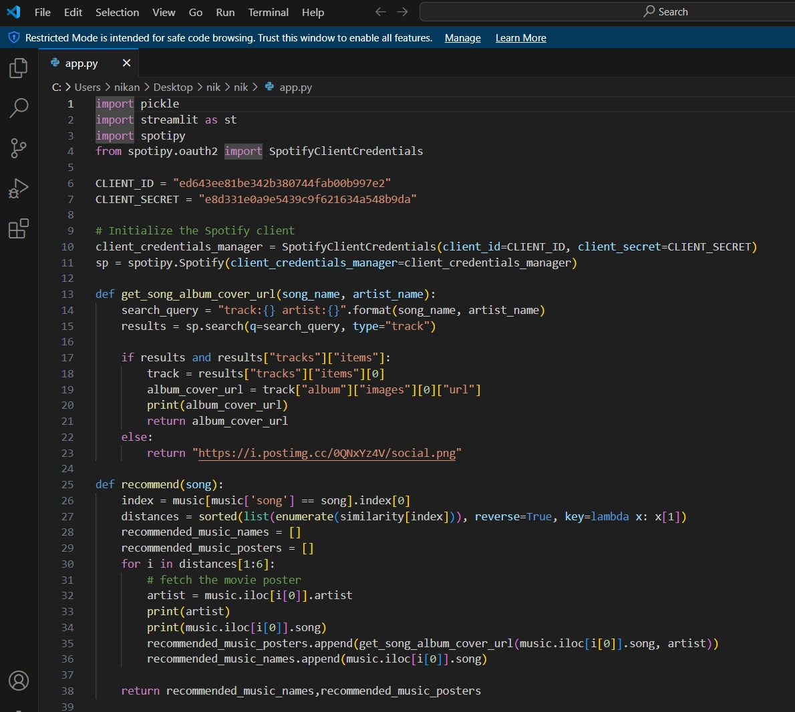
Final code for the application

Slide 7
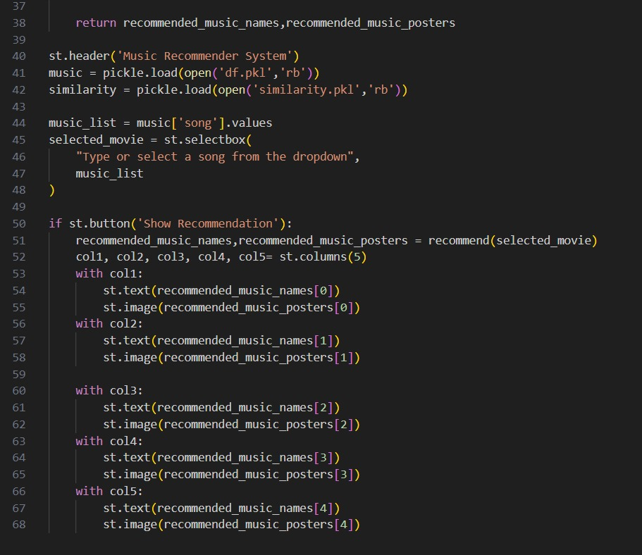
Part 2

Slide 8
References:
Kaggle Dataset: Click Here for dataset
Streamlit setup: Click here for Setup
Pandas DataFrame: Click here for the link
TF-IDF Vectorization: Click her for the link

Slide 9
Thank You!!

